Slide 1
Oskari for developers

Slide 2


Oskari - developer perspective
Quick start using downloadable zip with bundled Tomcat
Light-weight customization using sample-application/server:
Template repository as base for customized applications
Application customization
Adding custom functionalities
Version upgrades usually easy to do:
Bump dependency version
Automatic database migrations
Change log on oskari.org:
What’s new / changed
Migration guide
https://oskari.org/documentation/docs/3.1.0/12-Changelog
When doing changes or new functionalities, consider if it could be included in the Oskari repositories
Pull requests are accepted
Can be easier way to document/maintain functionalities
Let others benefit as well

Slide 3
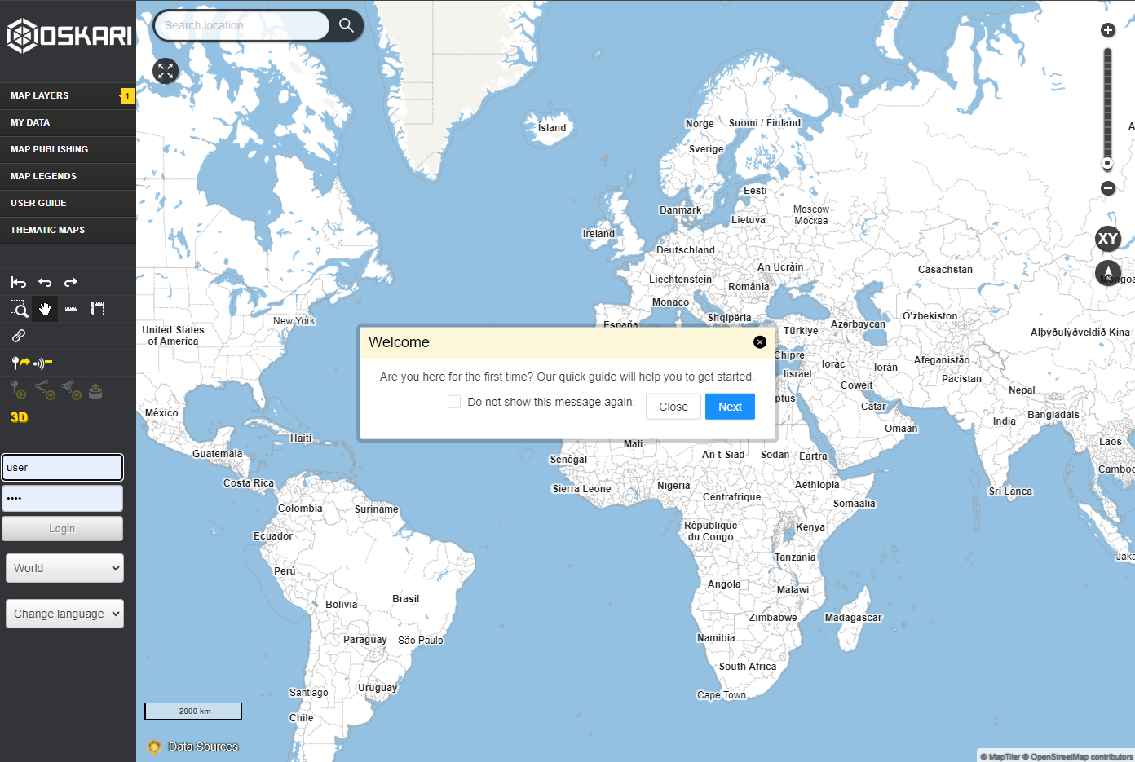
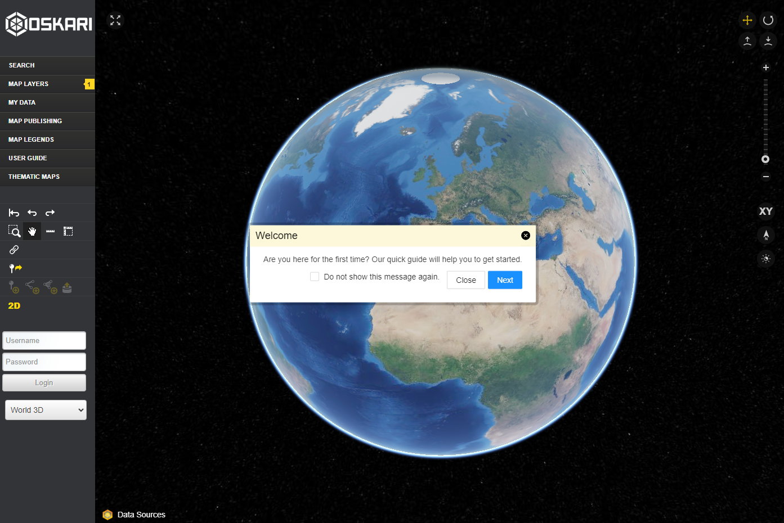
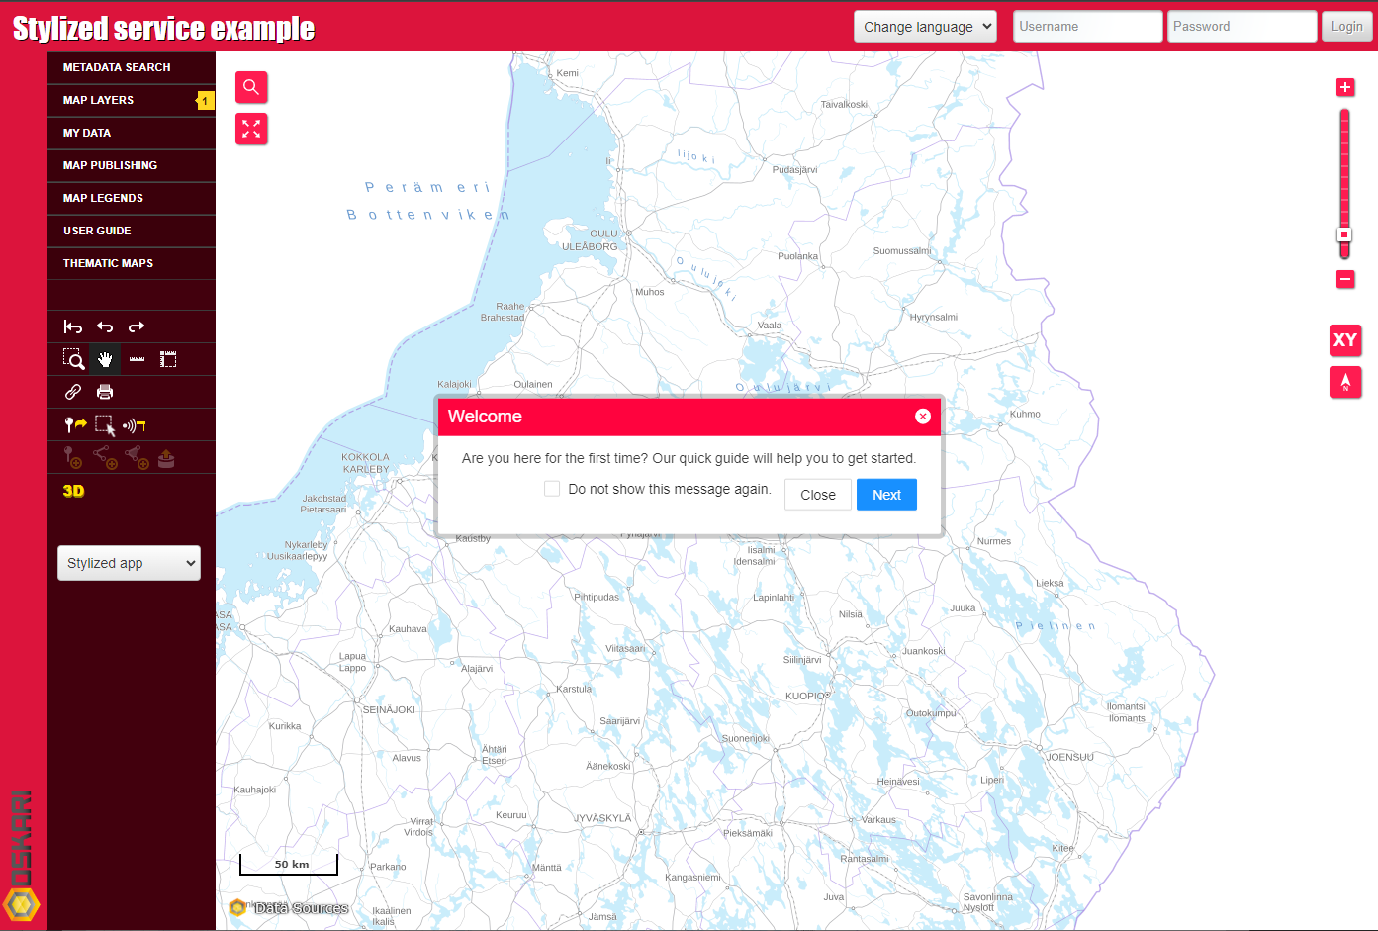
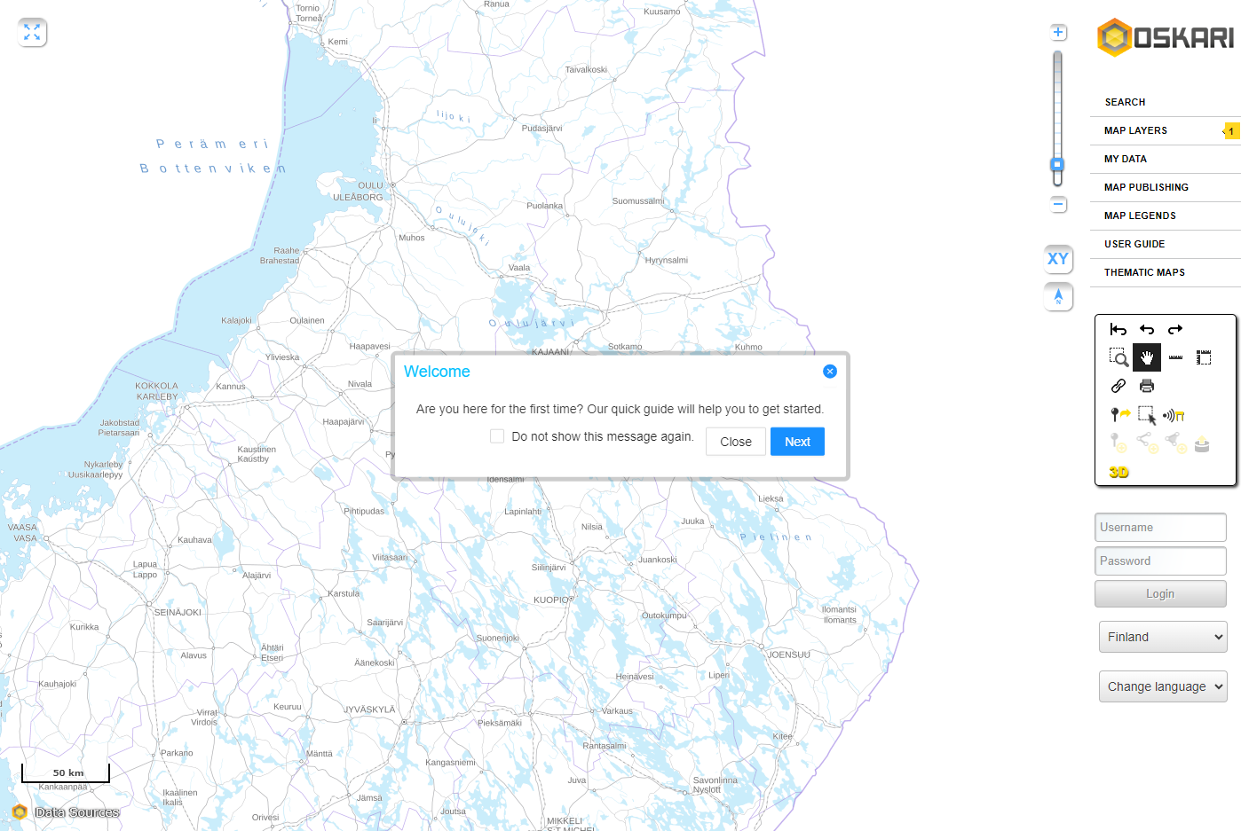

Slide 4
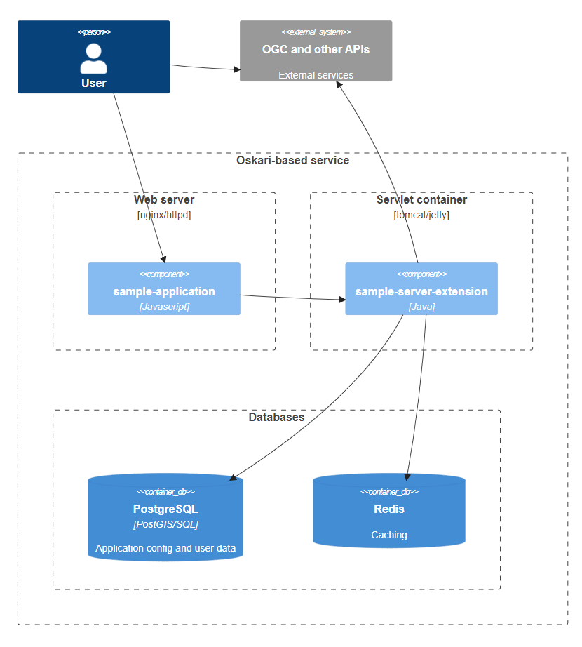
Runtime environment
Java-based web app
Tomcat/Jetty
PostgreSQL(+PostGIS)
Redis
Javascript SPA
API-integrations:
WMS/WMTS/WFS etc OGC-APIs
Vector tile
Bing, ArcGIS
Statistical data PxWeb, SotkaNET
Search backend

Slide 5
Main configuration file: oskari-ext.properties
# change to match your database connection parameters db.url = jdbc:postgresql://localhost:5432/oskaridb db.username = oskari db.password = oskari
Overrides using ENV-variables:
OSKARI_DB_URL=jdbc:postgresql://somehost:5432/somedb OSKARI_DB_USERNAME=someuser OSKARI_DB_PASSWORD=passwd

Slide 6

Open source
https://github.com/oskariorg
sample-server-extension
oskari-server
sample-application
oskari-frontend
oskari-frontend-contrib

Slide 7
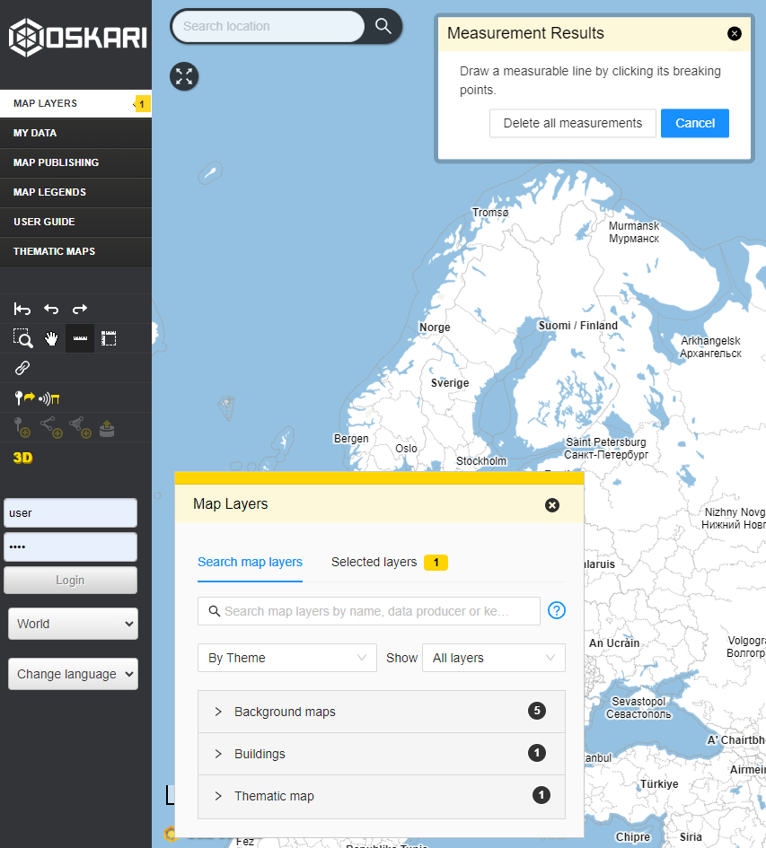
UI-concepts
“tile”
“flyout”
“bundle”
“app setup”
“popup”
“toolbar”
“plugin”
“event”
“request”
“action route”

Slide 8
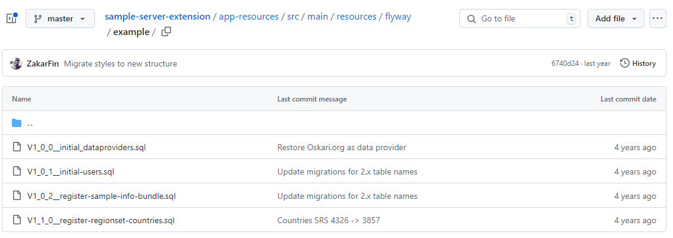
Customization: default content/functionality setup

Slide 9
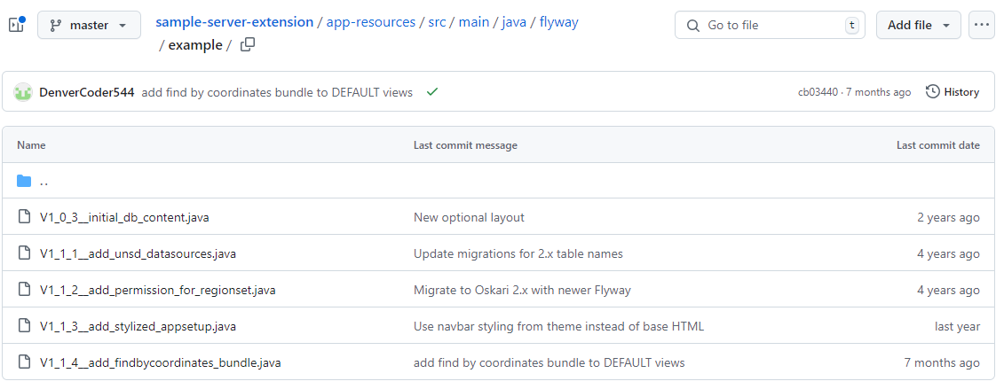
Customization: default content/functionality setup

Slide 10
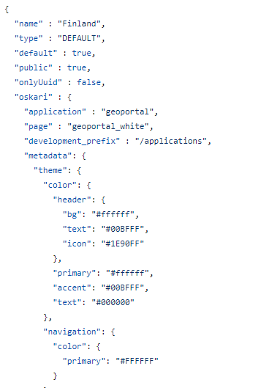
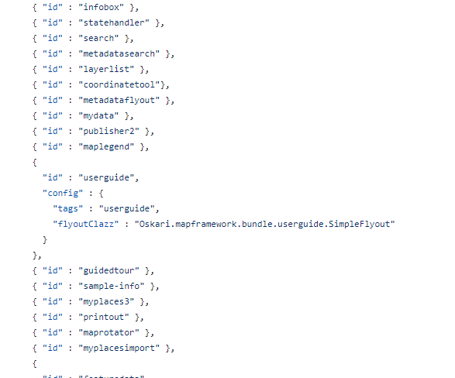
Customization
App setup
Theme
Functionalities
sample-server-extension/
app-resources/src/main/
resources/json/apps/
geoportal-3067.json

Slide 11
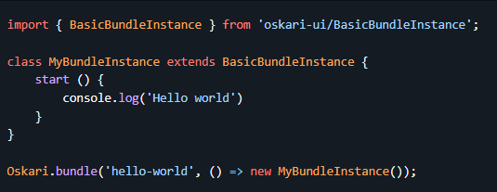
Oskari 3.x and beyond
Java version updated from 8 to 17
Can be run with more recent versions as well.
Frontend loader changes
packages/*/bundle.js on their way out, new way: bundles/*/index.js
https://github.com/oskariorg/oskari-frontend/pull/2886
locales automagically detected
New base bundle:

Slide 12
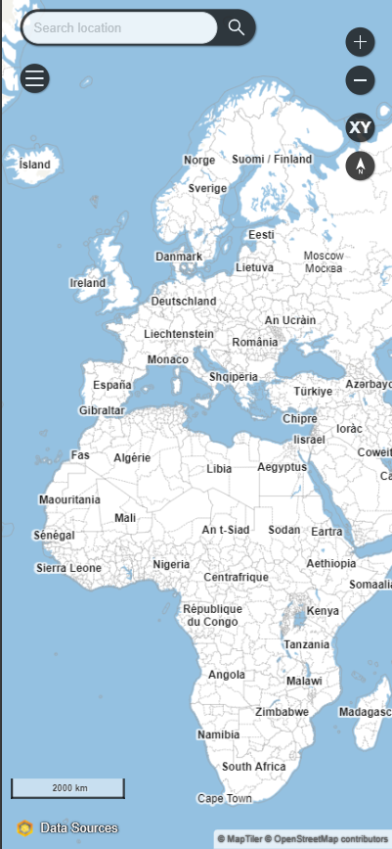
Example integration: search
Concept: SearchChannel
Backing service for search can be anything really:
Nominatim OpenStreetMap
MML Geokoodauspalvelu
WFS-services
Any custom backend
Searching using coordinates/reverse geocoding also an option.

Slide 13
Oskari-development
Developed using pull requests through GitHub
oskari-frontend
oskari-server
Changelog/migration guides for applications:
Release notes
Migration guide
Template application repository
(Paikkatietoikkuna repository github.com/nls-oskari)
Possible to ask questions in Gitter chat, for example

Slide 14

Thank you!
Website: https://oskari.org/
GitHub: https://github.com/oskariorg/
LinkedIn: Oskari - Open Source
Email: info@oskari.org

